Slide 1
04-Shooting Rubber band
Die OPPS-Luis Cornely

Slide 2
The Task
A rubber band may fly a longer distance if it is non-uniformly stretched when shot, giving it spin. Optimize the distance that a rubber band with spin can reach.
This process of non uniformly stretching the rubber band will be referred to as twisting.

Slide 3

Relevant parameters
The Mass of the Rubber band m
The spring constant K
The change in Length per side $∆X1,$ $∆X$2
The height it gets shot from
Density of the air around it $ρ$
Gravitational acceleration g

Slide 4
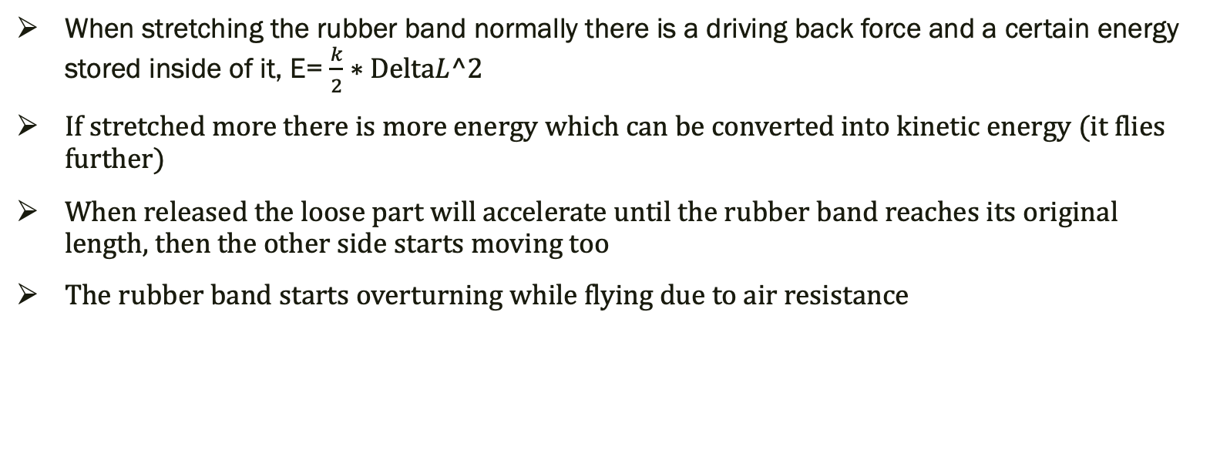
Basic explanation-Normal Shot
When stretching the rubber band normally there is a driving back force and a certain energy stored inside of it, E= $\frac{k}{2}∗DeltaL^2$
If stretched more there is more energy which can be converted into kinetic energy (it flies further)
When released the loose part will accelerate until the rubber band reaches its original length, then the other side starts moving too
The rubber band starts overturning while flying due to air resistance

Slide 5
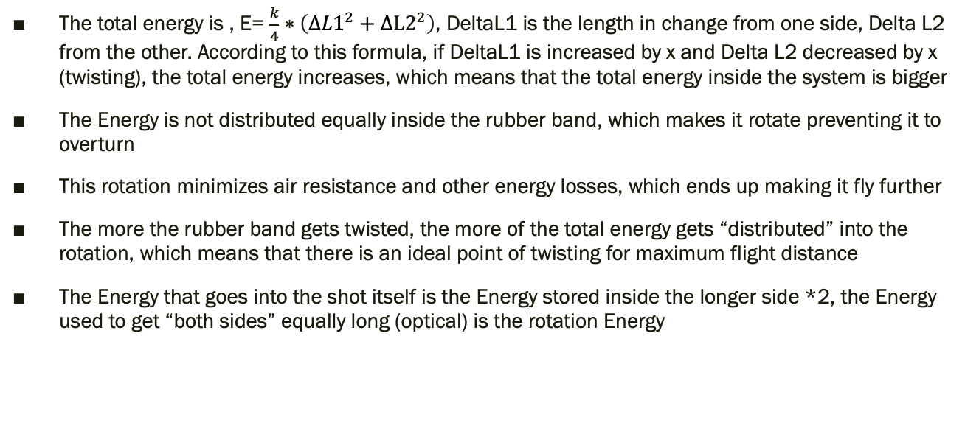
Basic explanation Twister shot
The total energy is , E= $\frac{k}{4}∗\left(∆{L1}^{2}+∆L2^{2}\right)$, DeltaL1 is the length in change from one side, Delta L2 from the other. According to this formula, if DeltaL1 is increased by x and Delta L2 decreased by x (twisting), the total energy increases, which means that the total energy inside the system is bigger
The Energy is not distributed equally inside the rubber band, which makes it rotate preventing it to overturn
This rotation minimizes air resistance and other energy losses, which ends up making it fly further
The more the rubber band gets twisted, the more of the total energy gets “distributed” into the rotation, which means that there is an ideal point of twisting for maximum flight distance
The Energy that goes into the shot itself is the Energy stored inside the longer side *2, the Energy used to get “both sides” equally long (optical) is the rotation Energy

Slide 6

Shooting the Rubber band- Theory
h
L
Without air resistance the rubber band will hit the floor after $∆T=\sqrt{2∗\frac{h}{g} }$
Assuming that E_{pot}=E_{kin}, the Starting Velocity V₀ can get calculated, solving after x, V₀=$\sqrt{k/m}∗X,$
S= $∆T$*V₀=$\sqrt{\frac{2∗k∗h}{g∗m}}$*X

Slide 7
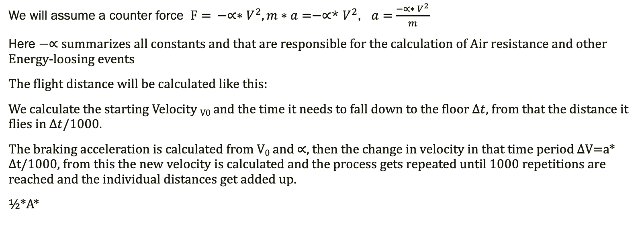
Shooting the rubber band Theory
We will assume a counter force $F= −∝∗V^{2}, m∗a=−∝$* $V^{2}$, $a=$ $\frac{{−∝∗ V}^{2}}{m}$
Here $−∝$ summarizes all constants and that are responsible for the calculation of Air resistance and other Energy-loosing events
The flight distance will be calculated like this:
We calculate the starting Velocity _{V0} and the time it needs to fall down to the floor $∆t$, from that the distance it flies in $∆t$/1000.
The braking acceleration is calculated from V₀ and $∝,$then the change in velocity in that time period $∆$V=a* $∆$t/1000, from this the new velocity is calculated and the process gets repeated until 1000 repetitions are reached and the individual distances get added up.
½*A*

Slide 8
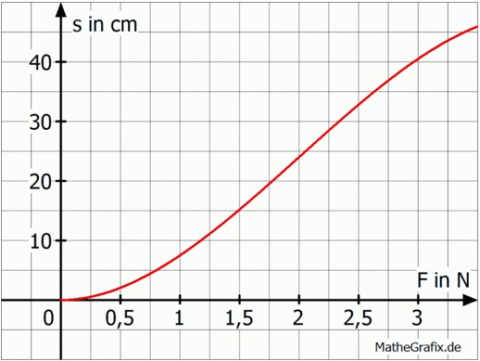
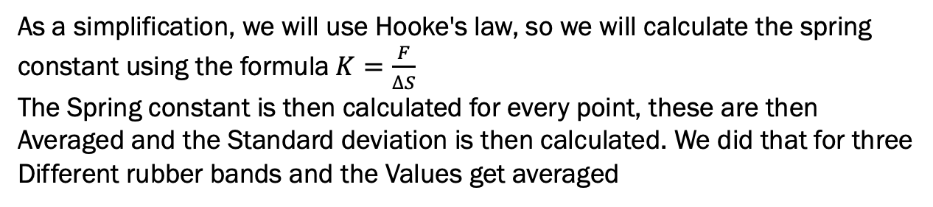
Spring constant Theory
Ideal Graph for S(F)
This section is linear
As a simplification, we will use Hooke's law, so we will calculate the spring
constant using the formula$K=\frac{F}{∆S}$
The Spring constant is then calculated for every point, these are then
Averaged and the Standard deviation is then calculated. We did that for three
Different rubber bands and the Values get averaged

Slide 9
Spring constant-Setup
A mass gets hung on a rubber band and the change in length resulting from it measured with a ruler
This gets repeated for 3 different rubber bands of the same kind, we will calculate the spring constant for each and average these.
Ruler
Rubber band
Mass

Slide 10




Results-Green
Change in Length
Force
KGreen1: 0,58N/cm
KGreen2: 0,49N/cm
KGrün3: 0,56N/cm
$∆K$green1: $±$0,09 N/cm
$∆K$green2: $±$0,05 N/cm
$∆K$green3: $±$0,05 N/cm
Agreen: 0,54 N/cm
A$∆K$green: $±$0,07 N/cm

Slide 11





Results blue
$$∆L in cm$$
Force in N
Kblue1: 0,52N/cm
Kblue2: 0,5N/cm
Kblue3: 0,42N/cm
$∆K$blue1: $±$0,03 N/cm
$∆K$blue2: $±$0,05 N/cm
$∆K$blue3: $±$0,03 N/cm
Ablue: 0,48 N/cm
A$∆K$blue: $±$0,04 N/cm

Slide 12




Results-orange
Change in Length
N
Korange1: 0,56N/cm
Korange2: 0,53N/cm
Korange3: 0,53N/cm
$∆k$orange1: $±$0,03 N/cm
$∆k$orange2: $±$0,05 N/cm
$∆k$orange3: $±$0,06 N/cm
Aorange: 0,54 N/cm
A$∆k$orange: $±$0,05 N/cm

Slide 13
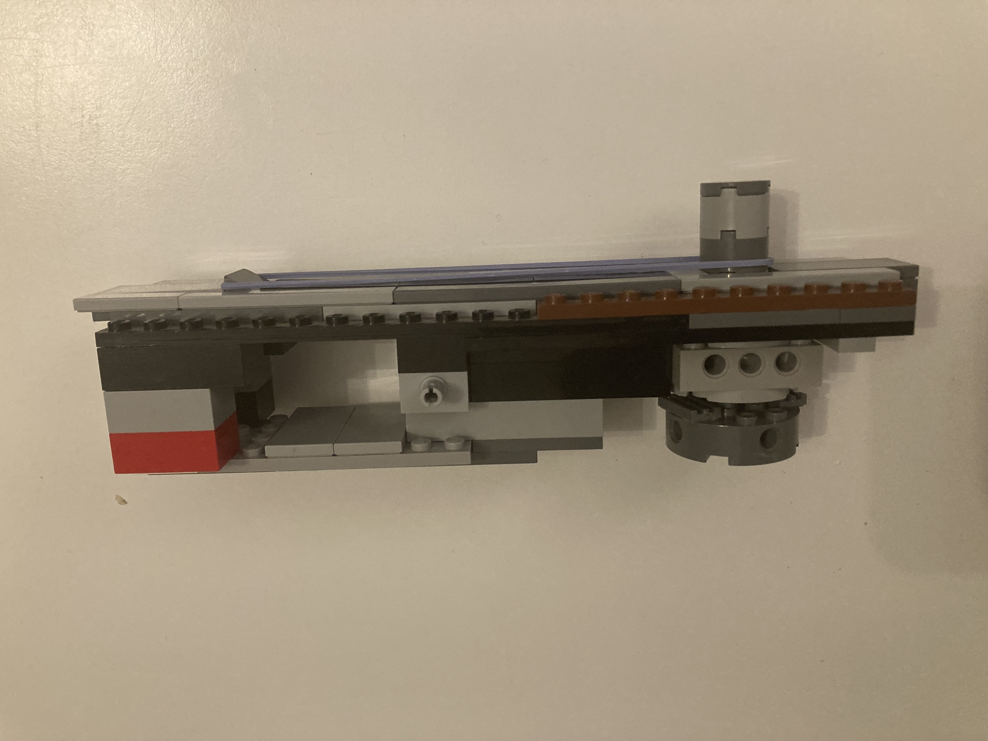
Experimental setup - Shooting
The angle to the desk will always be 0°
The height from which it will be shot is always 75,5cm
Rubber band
Movable Lego Part
Lego contraption
This part can be rotated to twist the rubber band
and pulled out fast to make the rubber band shoot
Rubber band

Slide 14
Results-Blue
Distance
Distance
Twist in 10%
Colour | Gray: | Yellow | Brown
Spin | 0% | 5% | 10%
Average distance | 613,8 | 640,5 | 644
This lets assume that the ideal Spin lies between a 5 and 10%
twist or that the distance grows slower when approaching
the ideal twist

Slide 15
Results green
Flight distance
Colour | Gray: | Yellow
Spin | 0% | 10%
Average distance | 606,56 | 677,6

Slide 16
Results Orange
Flight distance
Colour | Gray: | Yellow
Spin | 0% | 10%
Average distance | 604,59 | 624,2

Slide 17
Comparison between rubber bands
Flight distance
Flight distance
Energy
There is an upward trend overall with increasing angle
Energy
This shows that the Energy that goes into launching forward does not say much about the flight distance by itself, but it in relation to the Energy in the Rotation

Slide 18
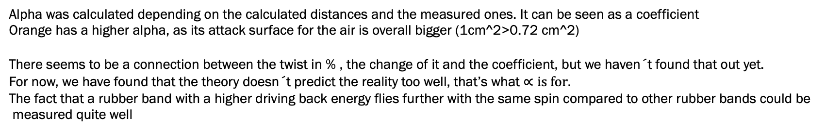
Theory-Experiment comparison
Alpha
 | Orange | Blue |  |  | Blue | Orange
0% | 0,000097 | 0,0000655 |  | 0%-5% | 14%
5% |  | 0,0000565 |  | 0%-10% | 20% | 15%
10% | 0,000082 | 0,000053 |  | 5%-10% | 6%
Alpha was calculated depending on the calculated distances and the measured ones. It can be seen as a coefficient
Orange has a higher alpha, as its attack surface for the air is overall bigger (1cm^2>0.72 cm^2)
There seems to be a connection between the twist in % , the change of it and the coefficient, but we haven´t found that out yet.
For now, we have found that the theory doesn´t predict the reality too well, that’s what $∝is for.$
The fact that a rubber band with a higher driving back energy flies further with the same spin compared to other rubber bands could be
measured quite well

Slide 19
Overall Error Analysis
The rubber bands wore out quite fast
The shooting distance might have varied by 1 cm as the desks are not all the same
Measurement errors
Friction with the Lego contraption

